Slide 1
Adult Dataset – EDA
Cheeta Community EDA project by
Tirth Darji

Slide 2
Dataset Overview
Rows: 25,000
Columns: 15
Numeric Columns: 6
Missing Values: 3,248 (0.9%)

Slide 3
Key Metrics (KPIs)
Total Rows
25,000
Total Columns
15
Total Missing Values
3,248 (0.9%)
Average Age
38.6
Avg Hours/Week
40.4
% >50K (approx)
23.9%

Slide 4
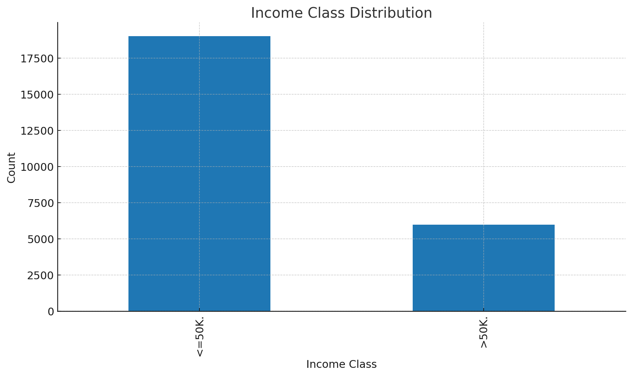
Income Class Distribution

Slide 5
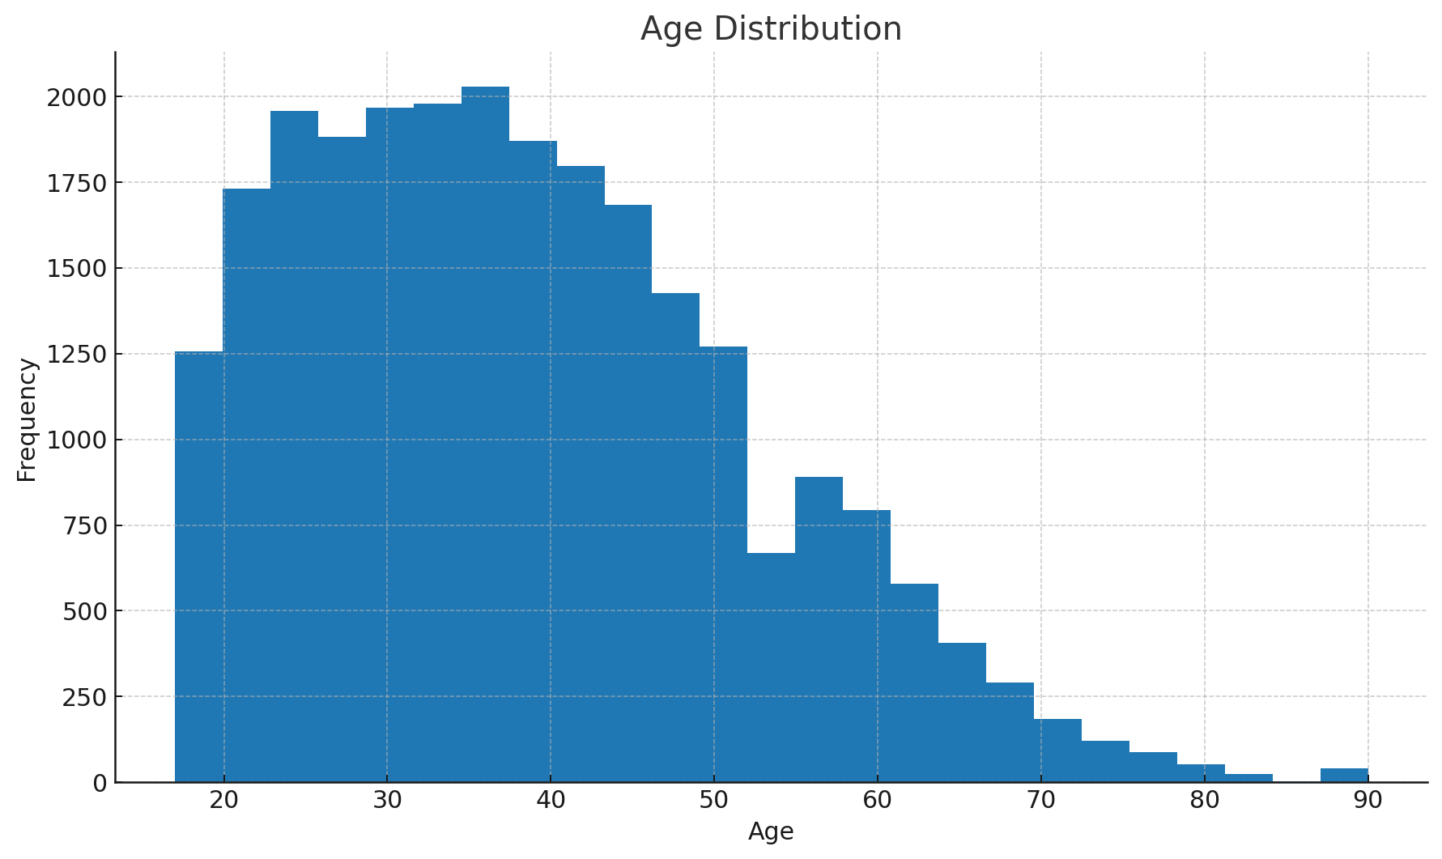
Age Distribution

Slide 6
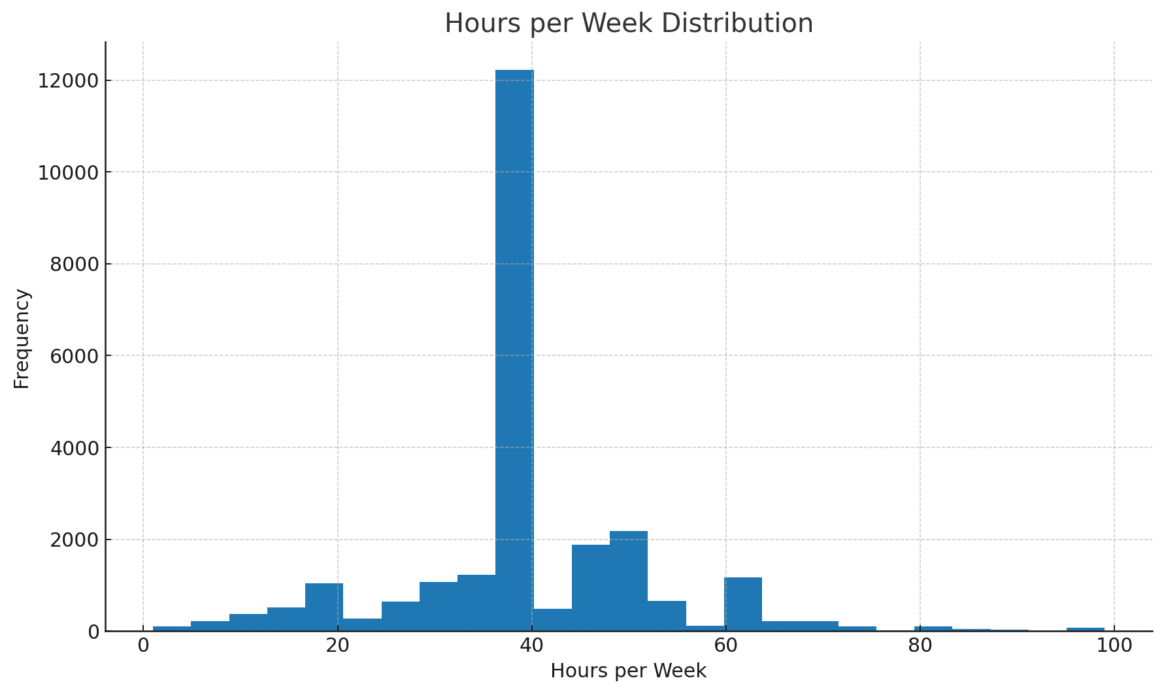
Hours per Week Distribution

Slide 7
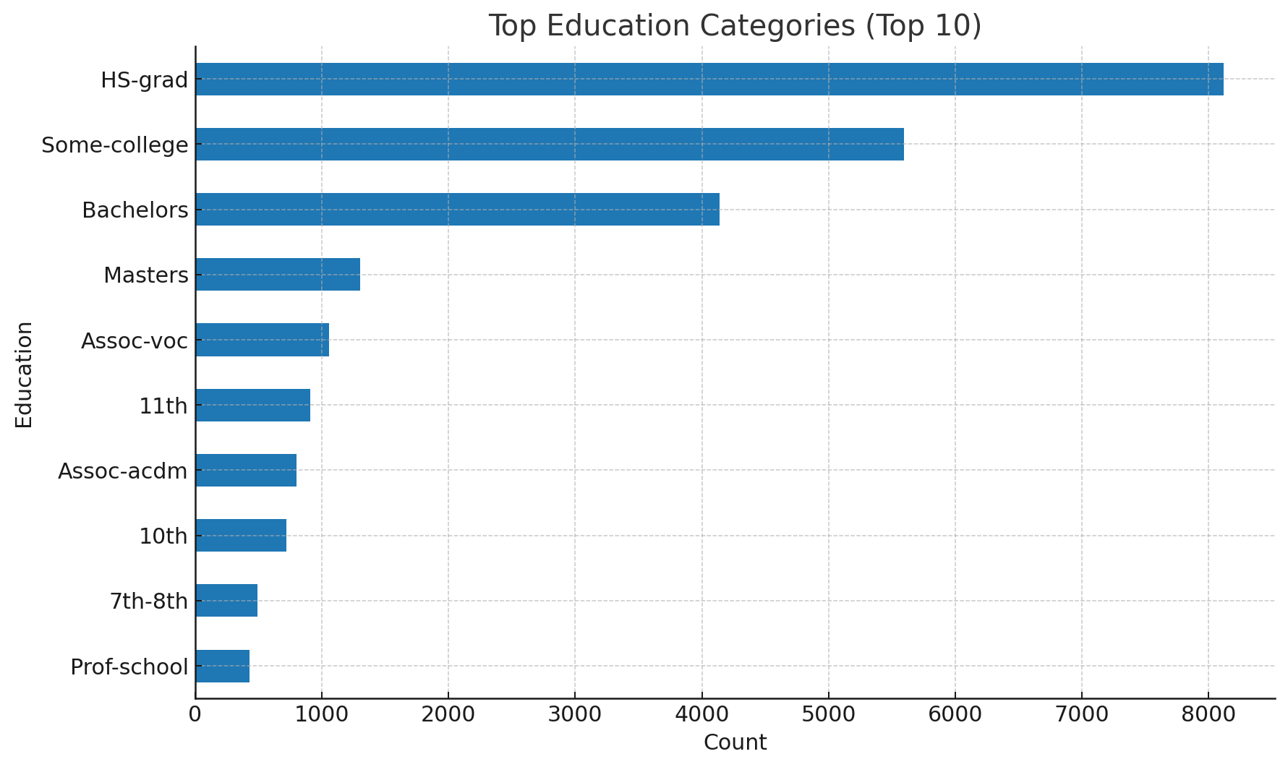
Education Overview

Slide 8
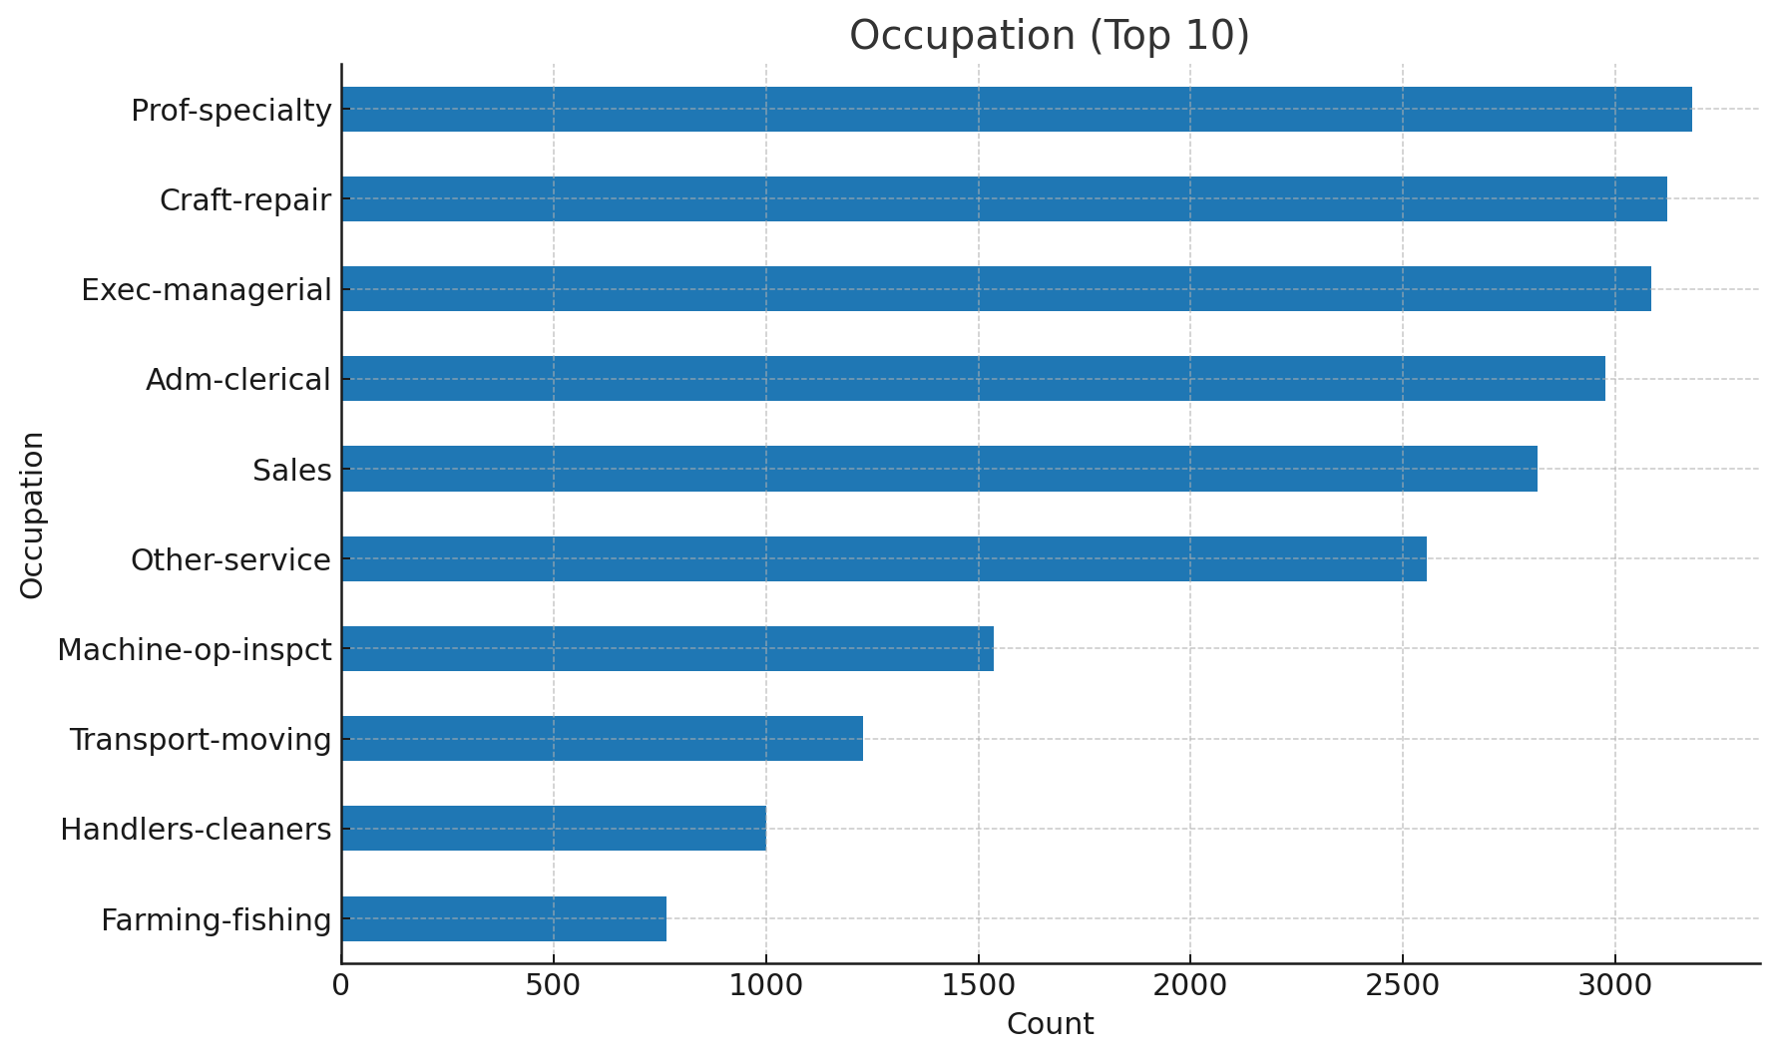
Occupation (Top 10)

Slide 9
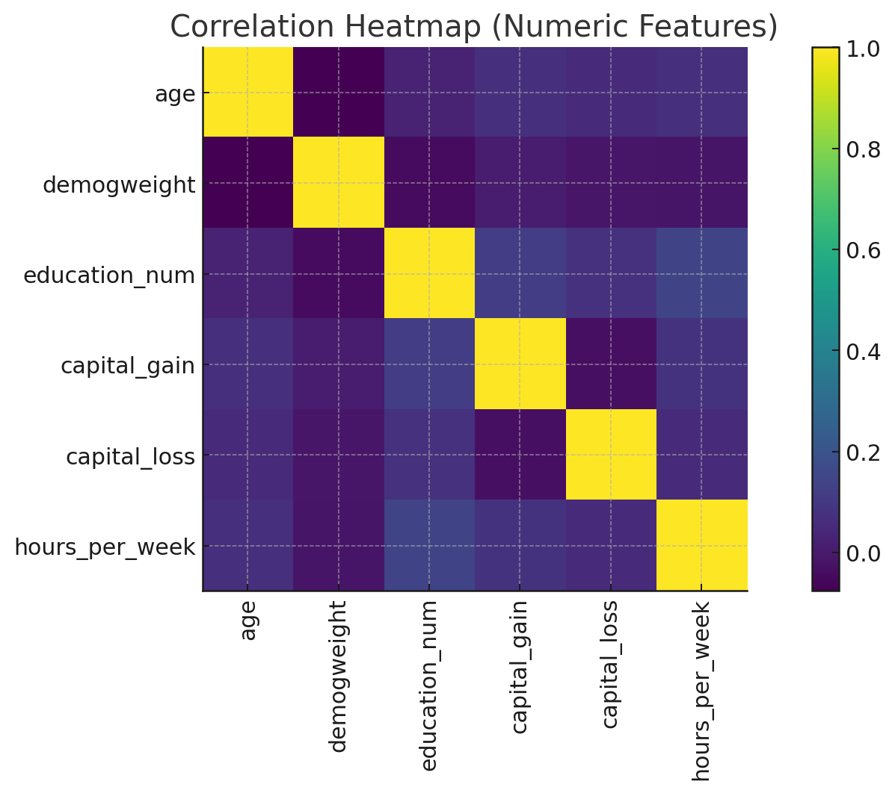
Correlation Heatmap

Slide 10
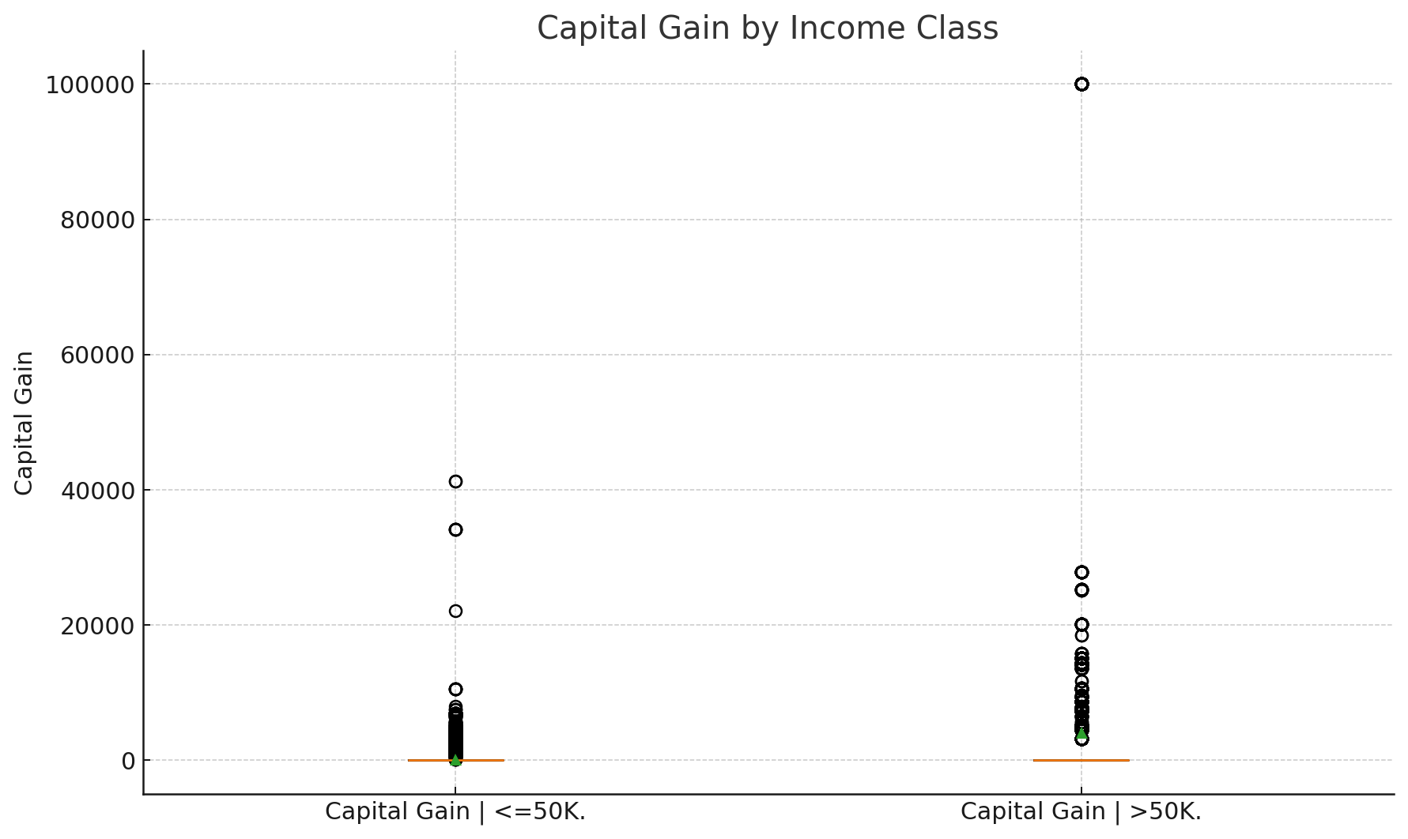
Capital Gains/Losses by Income

Slide 11
Auto-Generated Insights
• Most common income class: <=50K. (~76.1%).
• Median age is 37.0; IQR ~ 20.0.
• Average weekly hours: 40.4.
• Most common education: HS-grad.
• Top occupation: Prof-specialty.
• Strongest numeric correlation: education_num vs hours_per_week (r ≈ 0.15).

Slide 12
https://drive.google.com/file/d/1qI0FL3efHfPJj4EDgRtXR5igrQFKS_PM/view?usp=sharing
Code

